Slide 1
Introduction
to
Power Electronics
By
Dr. Irfan Ahmed

Slide 2
DC to AC Converters or Inverters

Slide 3
Necessity of Inverters
Types
Devices Used

Slide 4
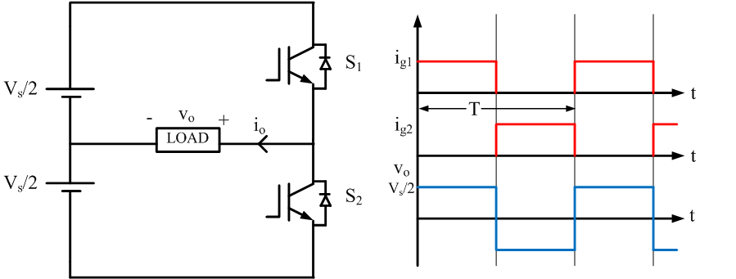
Single Phase Half-Bridge Voltage-Source Inverter (VSI)

Slide 5
Single Phase Full-Bridge Inverter

Slide 6
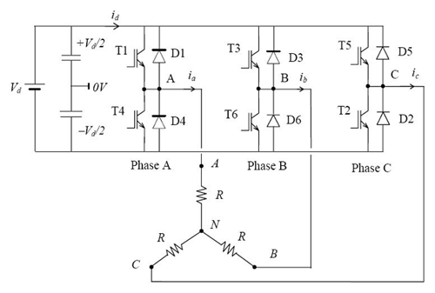
Three Phase Bridge VSI

Slide 7
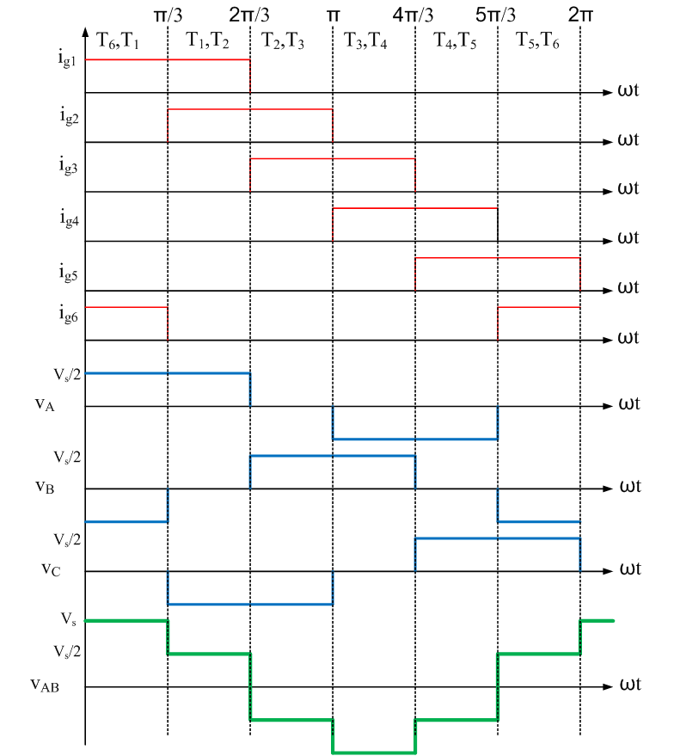
120° Mode Operation

Slide 8
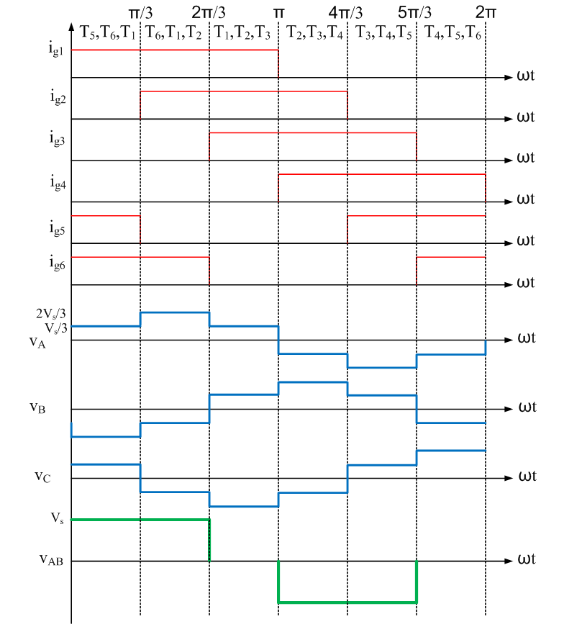
180° Mode Operation

Slide 9
AC to DC Converters or Rectifiers

Slide 10
Necessity of Rectifiers
Types
Devices Used

Slide 11
Single Phase Half Wave Controlled Rectifier (Resistive Load)

Slide 12
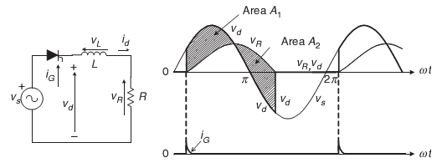
Single Phase Half Wave Controlled Rectifier (Inductive Load)

Slide 13
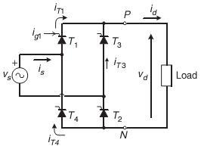
Single Phase Full Wave Fully Controlled Rectifier (Bridge Configuration)

Slide 14
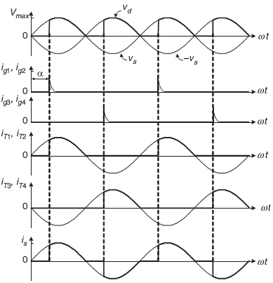
Waveforms with Resistive Load

Slide 15
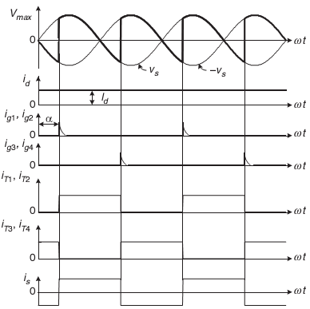
Waveforms with Inductive Load

